Slide 1
Cloud Computing
Deep Dive into Final Projects

Slide 2
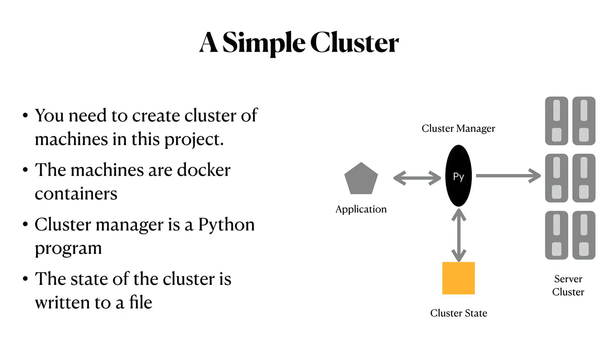
Notes:
Simple Cluster, Simple Python program, create a cluster/run applications/Save State(how many containers are running, how long has the container been running? All these info…What’s happeing in the cluster? Crashes. Observation of the cluster, Maintaining cluster status.)

Slide 3
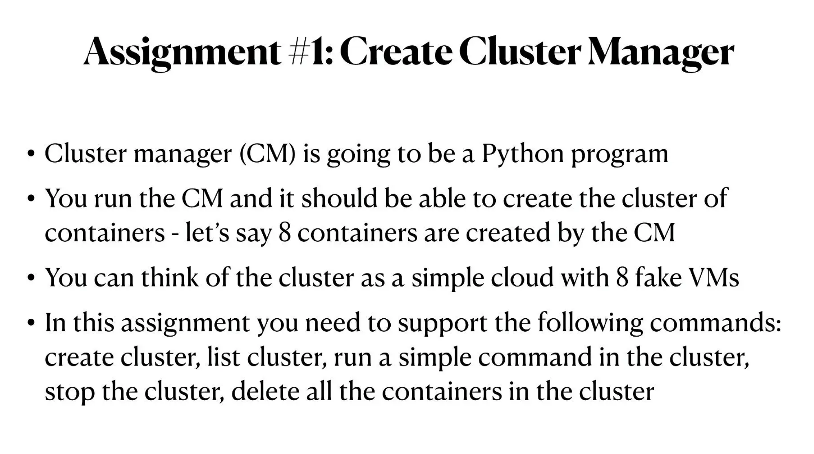

Slide 4
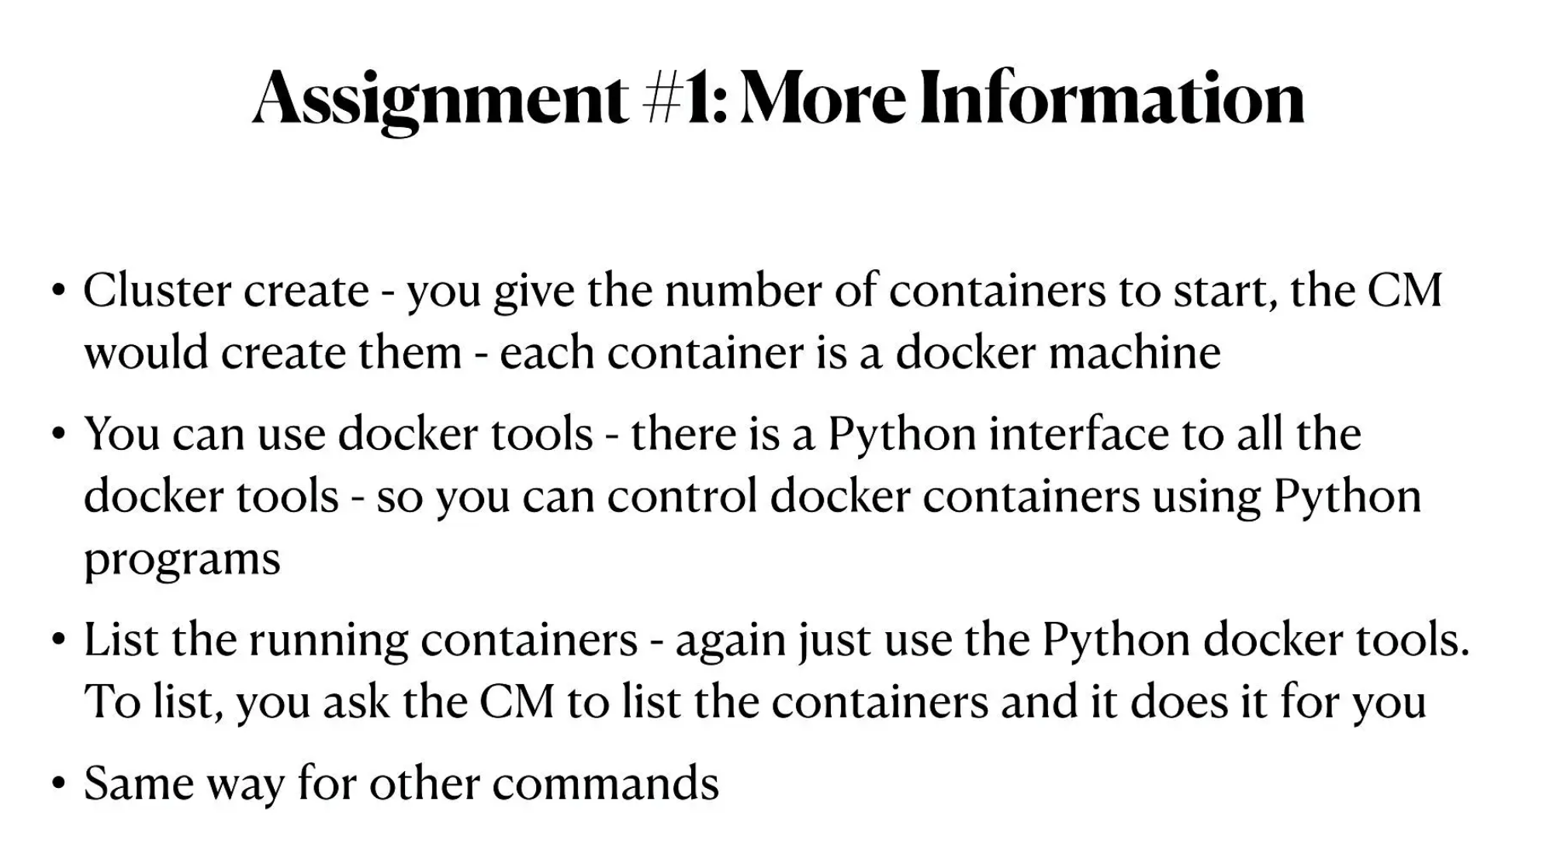

Slide 5
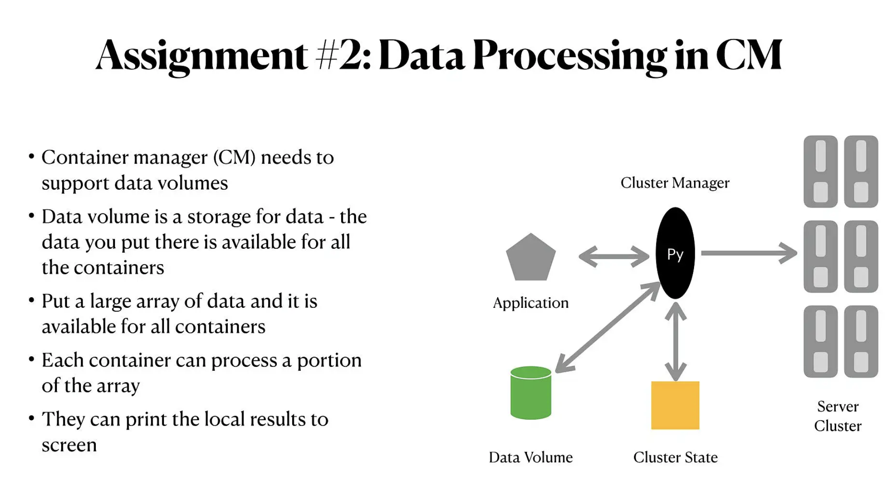
Notes:
Adding a data volume, has some files available for all containers. Each container does a portion of the data. Write data back to the volume.

Slide 6
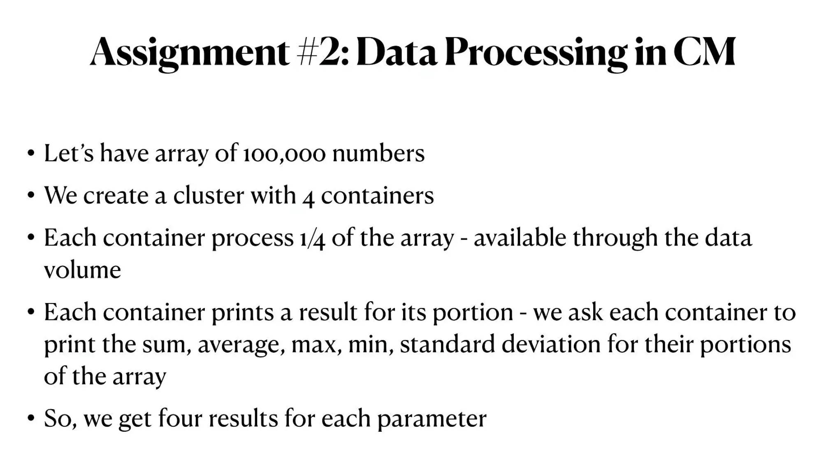

Slide 7
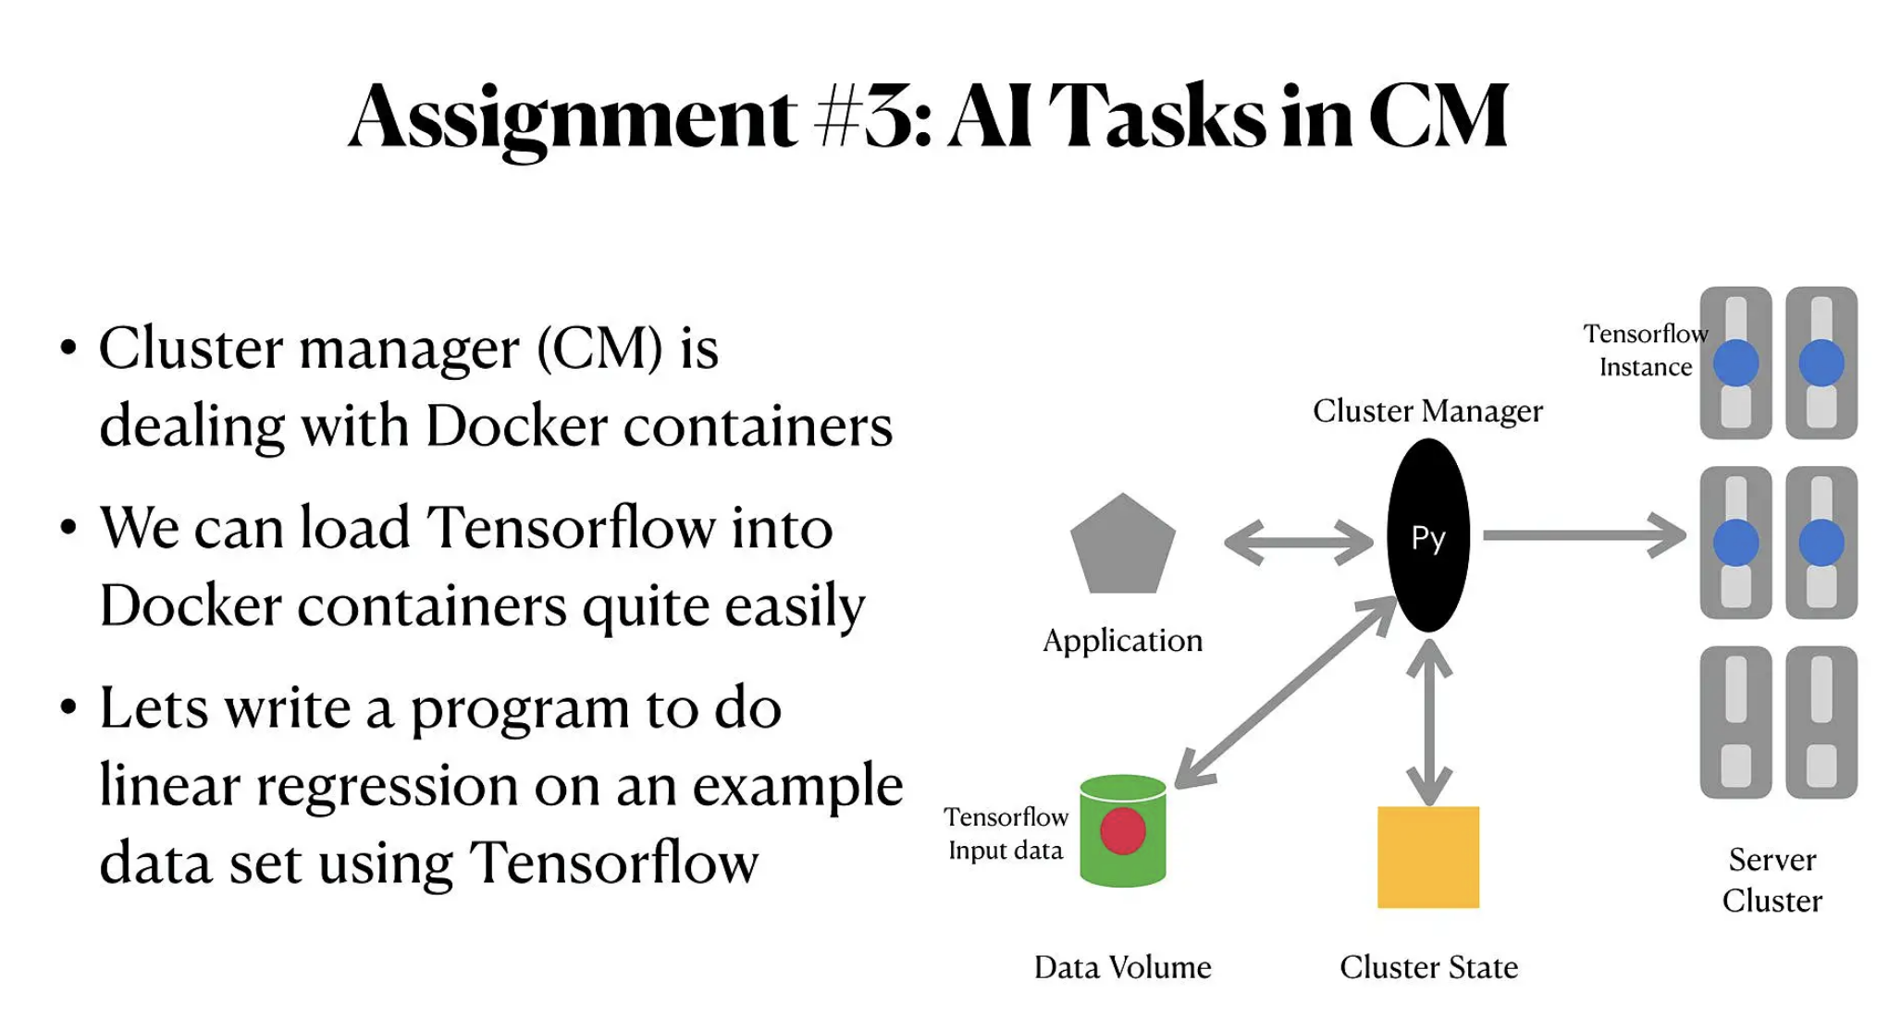

Slide 8
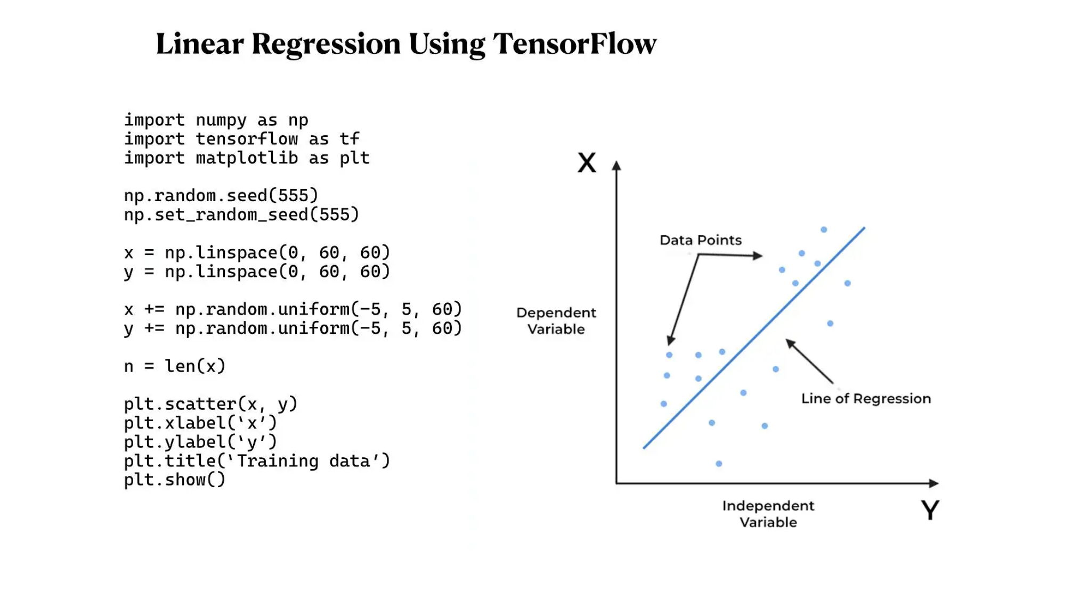

Slide 9
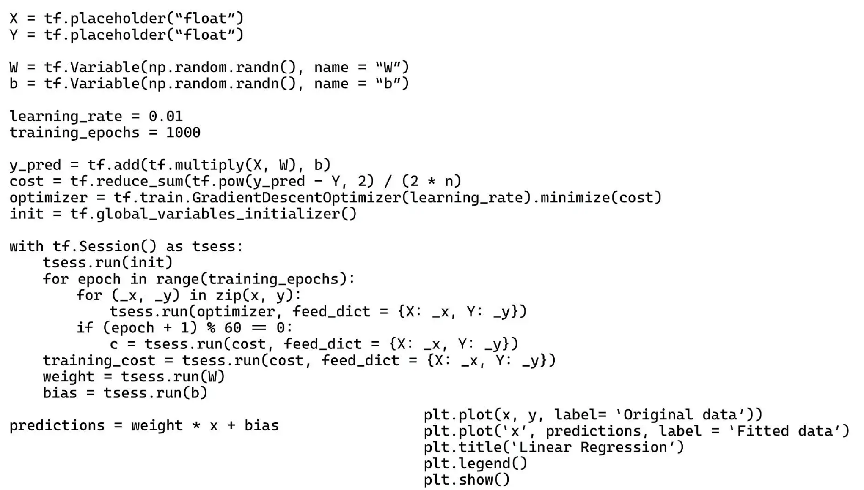

Slide 10
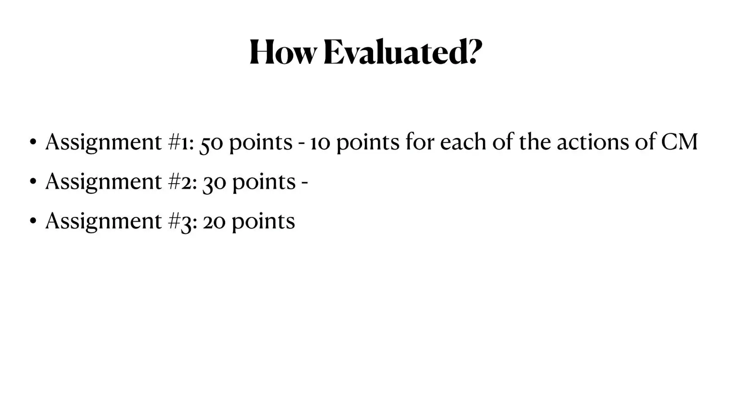
Notes:
Create/Add/Delete/Reduce/List

Slide 11
ML: Linear Regression
https://en.wikipedia.org/wiki/Linear_regression
1. TensorFlow: https://www.tensorflow.org/
Demo: https://www.geeksforgeeks.org/linear-regression-using-tensorflow/
2. PyTorch: https://pytorch.apachecn.org/#/
Demo: https://www.geeksforgeeks.org/linear-regression-using-pytorch/

Slide 12
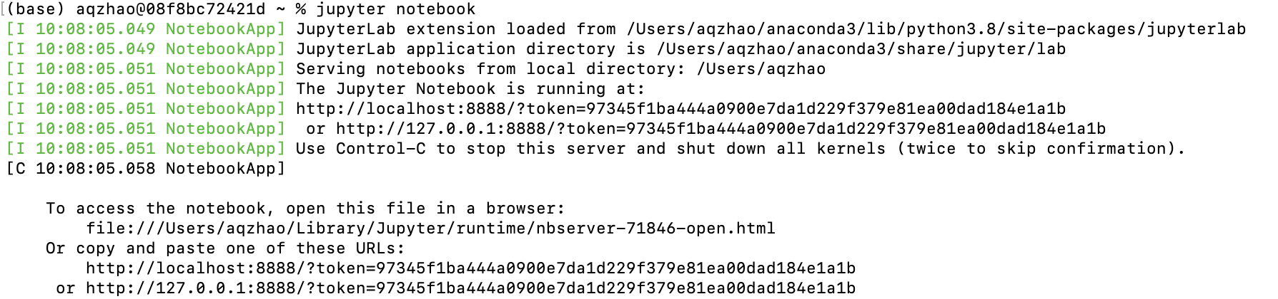
Jupyter Notebook
1. 安装 Jupyter Notebook: https://docs.jupyter.org/en/latest/install/notebook-classic.html
2. 开启: 在电脑终端输入命令 jupyter notebook

Slide 13
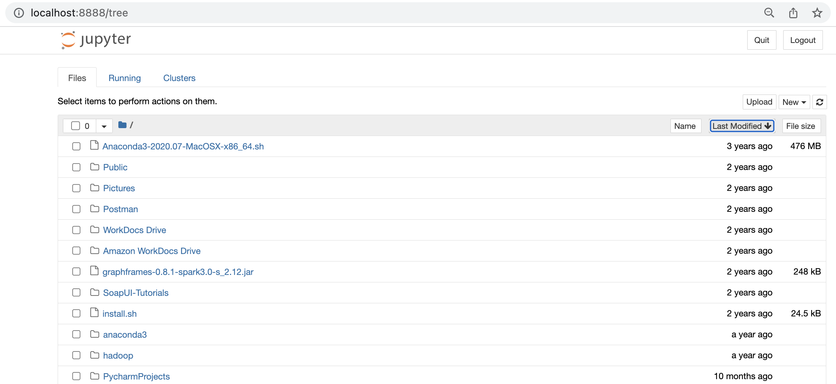
Jupyter Notebook
3. 浏览器自动打开如下页面：

Slide 14
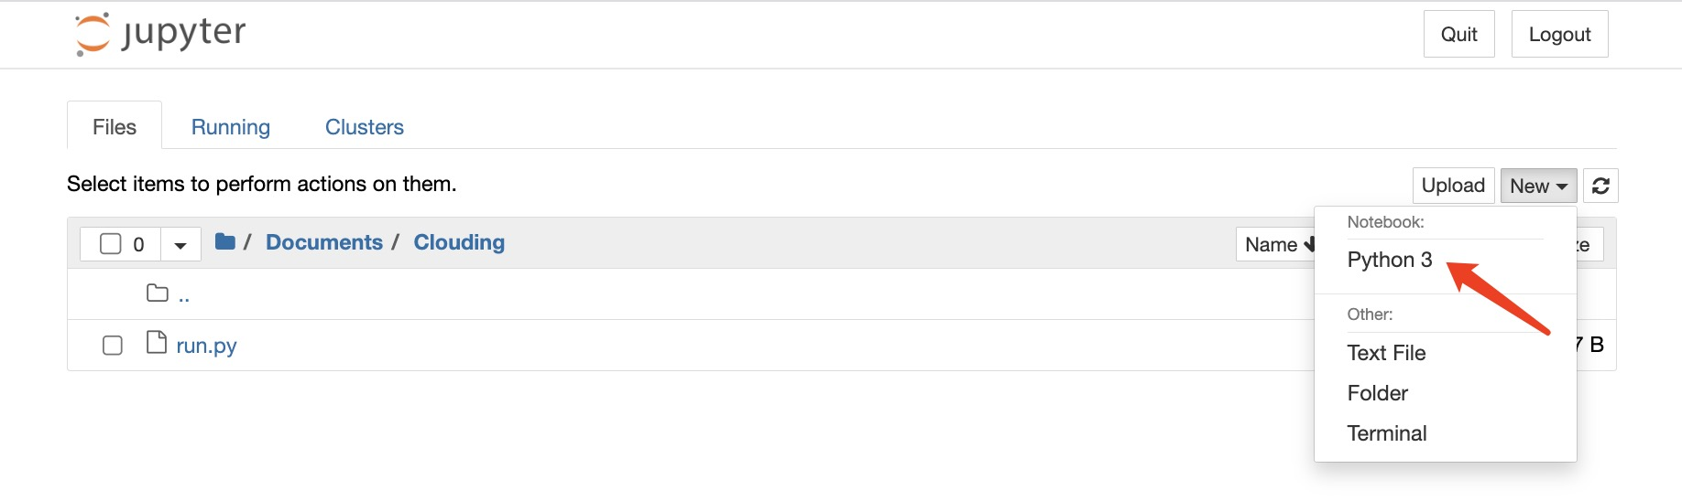
Jupyter Notebook
4. 进入大作业目录，创建需要的文: (选择Python 3)

Slide 15
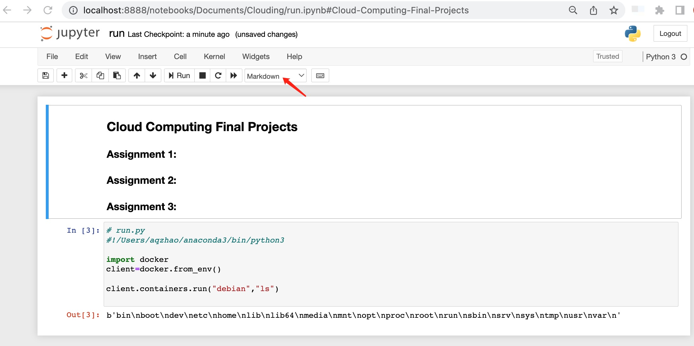
Jupyter Notebook
5. 添加说明性文字: (选择markdown)

Slide 16
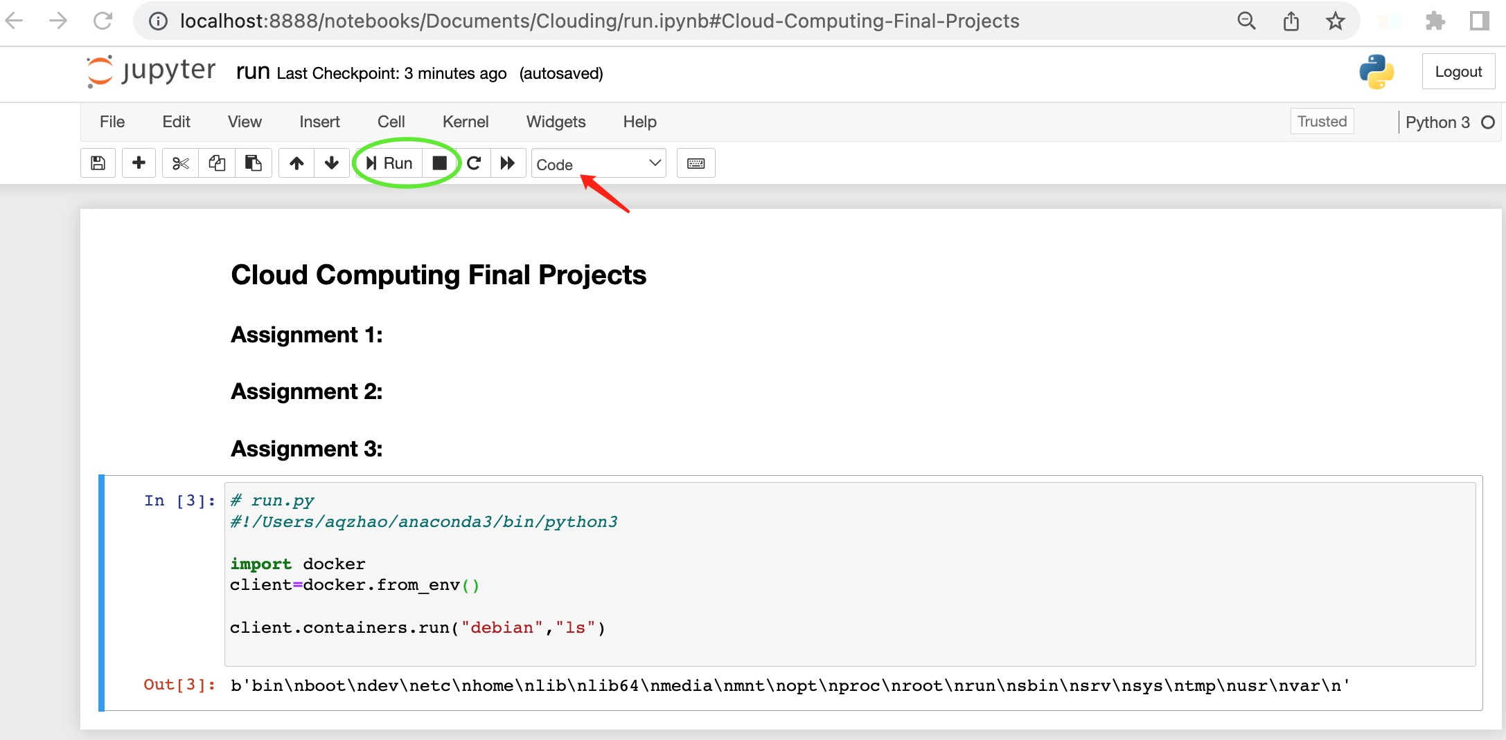
Jupyter Notebook
5. 添加代码模块，写代码并进行调试: (选择code)

Slide 17
Images, Containers, Volumes
关系，操作

